Slide 1
Full-text Scanning and Pattern Matching
COMP 336 Dik Lun LEE Department of Computer Science, HKUST, Slide <number>

Slide 2
Revisit on the Cost of Inverted File
Indexing (inverted file) causes too much storage and processing overhead
Post-processing of posting lists (merge and intersection) becomes more and more expensive
Inverted indexes are good for:
  relatively static databases
  large databases where retrieval speed must be very high (so that you are willing to pay the overheads introduced by the index)
Complex Boolean queries, proximity search, word truncations are complex operations
COMP 336 Dik Lun LEE Department of Computer Science, HKUST, Slide <number>
Notes:
In this second module, we first briefly discuss the Boolean retrieval module which is the simplest module and most of you have use it in library and WEB searches.
Following this, we will discuss the basic problem of search a keyword is a string, starting with a naïve algorithm using brute force method, followed by some more efficient algorithms. The term full text scanning is used because we actually scan the text directly instead using some other access methods such as indexes.

Slide 3
Full Text Scanning
No index maintained
Search conducted directly on the text itself
Requires pattern matching and logic to handle Boolean conditions
This is a long article on HKUST
hit
article
pattern
matcher
AND
HKUST
Query: article AND HKUST
COMP 336 Dik Lun LEE Department of Computer Science, HKUST, Slide <number>
Notes:
In this second module, we first briefly discuss the Boolean retrieval module which is the simplest module and most of you have use it in library and WEB searches.
Following this, we will discuss the basic problem of search a keyword is a string, starting with a naïve algorithm using brute force method, followed by some more efficient algorithms. The term full text scanning is used because we actually scan the text directly instead using some other access methods such as indexes.

Slide 4
Full Text Scanning
Advantages:
  No storage and processing overhead on the index
  Good for dynamic environment where documents are created/updated frequently
  Search is done on raw text - all information in the text is theoretically searchable (e.g., no stop words and stemming needed)
<h1>HKUST</h1><p>…</p><p>…computer…</p>
hit, doc#, loc, etc.
<p>*computer*</p>
hit
pattern
matcher
Query: “computer” appearing in second paragraph of a section titled “HKUST”
logic
<h1>HKUST</h1>
Disadvantages: Slow but acceptable for small set of documents (e.g., a personal collections of files
COMP 336 Dik Lun LEE Department of Computer Science, HKUST, Slide <number>
Notes:
In this second module, we first briefly discuss the Boolean retrieval module which is the simplest module and most of you have use it in library and WEB searches.
Following this, we will discuss the basic problem of search a keyword is a string, starting with a naïve algorithm using brute force method, followed by some more efficient algorithms. The term full text scanning is used because we actually scan the text directly instead using some other access methods such as indexes.

Slide 5
Other Applications
Where is pattern matching used in Google?
Indexing and pattern matching could be complementary
  Index: narrow down search space
  Pattern matching: fulfill complex search conditions
    A, B, C must exist in the same sentence
    Pages containing (any) date or (any) time information
Real-time filtering
  Virus scanning; packet scanning; news/financial data filtering
  A large set of patterns, data is real-time and cannot be delayed
    Even storing the data on hard disk before passing it to the application causes too much delay
COMP 336 Dik Lun LEE Department of Computer Science, HKUST, Slide <number>
Notes:
In this second module, we first briefly discuss the Boolean retrieval module which is the simplest module and most of you have use it in library and WEB searches.
Following this, we will discuss the basic problem of search a keyword is a string, starting with a naïve algorithm using brute force method, followed by some more efficient algorithms. The term full text scanning is used because we actually scan the text directly instead using some other access methods such as indexes.

Slide 6
Pattern Matching Algorithms
The elementary text-scanning operation, string search:
  Given a single keyword p (search string) and an input string s, answer “yes” if p occurs as a substring of s, that is, if s = xpy for some x and y, “no” otherwise.
Brute force string matching algorithm
Fast string matching algorithms
  The KMP algorithm
  The BM algorithm
[BR] Chap 8.5
[S] 8.6
[FB] Chap 10
COMP 336 Dik Lun LEE Department of Computer Science, HKUST, Slide <number>
Notes:
In this second module, we first briefly discuss the Boolean retrieval module which is the simplest module and most of you have use it in library and WEB searches.
Following this, we will discuss the basic problem of search a keyword is a string, starting with a naïve algorithm using brute force method, followed by some more efficient algorithms. The term full text scanning is used because we actually scan the text directly instead using some other access methods such as indexes.

Slide 7
The Brute Force Algorithm (1)
Search string (pattern): p₁p₂…p_{m}
Text string: s₁s₂…s_{n} (usually n >> m)
Compare pattern with the m -character substring s_{k}s_{k+1}…s_{k+m-1} for each successive value of k from 1 to n - m +1.
The pattern either matches the substring entirely or finds a position at which the corresponding characters from the pattern and the string don’t match
p₁ … p_{i} … p_{m}
s₁… s_{k} … s_{j}… s_{k+m-1} ...
COMP 336 Dik Lun LEE Department of Computer Science, HKUST, Slide <number>
Notes:
p: the keyword - a string to search for
S: the text -- a string to be searched
S: a b a b a b c a
P: a b c

Slide 8
The Brute Force Algorithm (2)
begin
  i := 1
  j := 1
  while i ≤ m and j ≤ n do
    if p_{i} = s_{j} then begin i := i +1; j := j +1 end
    else begin j := j - i + 2; i :=1 end
  if i > m then return “yes else return “no”
end
The loop can stop
earlier: j ≤ n - m + 1
at most
n × m
times
Conceptually the pattern is shifted to the right
Mismatch!
j=14-7+2=9
i=1
j=8
j=14
j=9
travel information
travel information
informing
informing
i=1
i=7
i=1
COMP 336 Dik Lun LEE Department of Computer Science, HKUST, Slide <number>
Notes:
The algorithm is rather straightforward

Slide 9
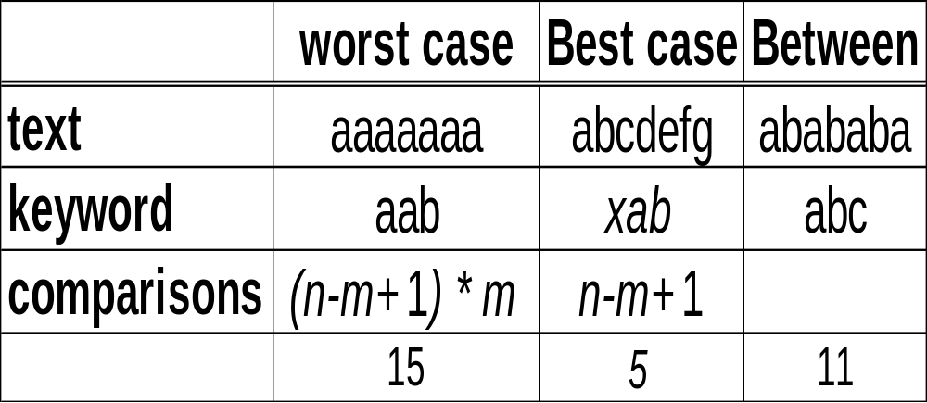
The Brute Force Algorithm -- Performance
mismatch found
at end of pattern
mismatch found
at beginning of pattern
COMP 336 Dik Lun LEE Department of Computer Science, HKUST, Slide <number>
Notes:
So, when the text is long, the search will be time-consuming.
Note that, in most cases, the probability of match is in fact low and mismatch is more often

Slide 10
Karp-Rabin: Application of Hashing to Pattern Matching
COMP 336 Dik Lun LEE Department of Computer Science, HKUST, Slide <number>

Slide 11
The Karp-Rabin Algorithm
Karp-Rabin algorithm uses a hash function to lower the cost of comparing the keyword with each successive m-character substring.
text string s
hash(s)
I_{p}
travel information
informing
=
pattern p
hash(p)
I_{s}
COMP 336 Dik Lun LEE Department of Computer Science, HKUST, Slide <number>
Notes:
The basic idea is that, the cost of comparing an integer is much cheaper than comparing two strings.
Applying a hash function to two strings, if the hash values are the same, the two strings may be identical. On the other hand, if the hash values are different, two strings could never be identical.

Slide 12
The Karp-Rabin Algorithm
Let h be a hash function that maps each m-character string to an integer
  If h(p₁p₂…p_{m}) ≠ h(s_{k}s_{k+1}…s_{k+m-1} ) then we know p₁p₂…p_{m} cannot possibly match s_{k}s_{k+1}…s_{k+m-1}
  If h(p₁p₂…p_{m}) = h(s_{k}s_{k+1}…s_{k+m-1} ), then we must still compare p₁p₂…p_{m} with s_{k}s_{k+1}…s_{k+m-1..} character by character to make sure we do not have a false match
s₂ (collison)
pattern
hash
I_{p}
=?
I_{s}
hash
s₁
COMP 336 Dik Lun LEE Department of Computer Science, HKUST, Slide <number>
Notes:
The basic idea is that, the cost of comparing an integer is much cheaper than comparing two strings.
Applying a hash function to two strings, if the hash values are the same, the two strings may be identical. On the other hand, if the hash values are different, two strings could never be identical.

Slide 13
Cost in Hashing
Hashing reduces m character comparisons to a single integer comparison, but the hash function must be very fast
  The pattern is hashed only once, so cost is not a big problem
  For the text string, the hash function is performed (n – m + 1) times!
Fixed-length hash code
abcdefghijk
= ?
cde
Fixed-length hash code
Hash function must be efficient
COMP 336 Dik Lun LEE Department of Computer Science, HKUST, Slide <number>

Slide 14
The Karp-Rabin Algorithm (2)
Karp and Rabin suggested using the hash function h(x) = x mod q where q is an appropriately large prime.
For m character string s_{k}s_{k+1}…s_{k+m-1}, compute
  x_{k} = s_{k} b^{m-1} + s_{k+1} b^{m-2} + … + s_{k+m-1}
  x_{k+1} = (x_{k} - s_{k} b^{m-1})b + s_{k+m}
abcde
string = abcde
ascii(a) = 97
m = 4
hash(“abcd”) = (97*2³ + 98*2² + 99*2¹ + 100*2⁰ ) % q = 1466 % q
hash(“bcde”) = (98*2³ + 99*2² + 100*2¹ + 101*2⁰ ) % q = 1481 % q
ascii(e)
hash(“bcde”) = [ ( 1466 - 97*2³) * 2 + 101 ] % q
Worst case O(mn) when hash values of pattern and text substring match all the time (unlikely!)
Expected O(m+n)
Under what situations that Karp-Rabin performs well?
COMP 336 Dik Lun LEE Department of Computer Science, HKUST, Slide <number>

Slide 15
KMP and BM Pattern Matching Algorithms
Improvements on Brute-Force pattern matching
COMP 336 Dik Lun LEE Department of Computer Science, HKUST, Slide <number>

Slide 16
The KMP Matching Algorithm
The brute force algorithm is slow because it needs to compare every m-character substring of the input text, which is not necessary.
Position 1 2 3 4 5 6 7 8
Text String a b d a d e f g
Pattern a b d f
a b d f
Brute force: shift 1 char; guarantee failure
a b d f
Even shifting 2 chars guarantees failure
a b d f
Smart: shift 3 chars
Mismatch occurs in position 4. The brute force algorithm will shift just one position.
Since the first three (text) positions matched (a b d), shifting the pattern by one position can’t produce a match with “a” because the second text character has already been identified as “b”.
After a prefix of the pattern has matched the text, you know something about the text string!
COMP 336 Dik Lun LEE Department of Computer Science, HKUST, Slide <number>

Slide 17
What you Matched is What you Know
Take advantage of the information known from compared character pairs in a mismatch to prevent from repeating comparisons with the known characters
Position 1 2 3 4 5 6 7 8
Text String a b d a d e f g
Pattern a b d f
Knowledge about the text: a b d ?
Need to find another “a” in the text string
I know “a” doesn’t appear in the next two characters, advance the pattern by 3 characters
Need to analyze the pattern characters in advance
To arrange the algorithm so that the pointer in the input text string is never decremented
COMP 336 Dik Lun LEE Department of Computer Science, HKUST, Slide <number>

Slide 18
Number of Characters to Shift when Mismatch
.. x x x x ..
If the pattern is shift by 1 position
could we find a match?
By examining the pattern prefix a b d, one can conclude that a mismatch is guaranteed because if x matched b, it cannot match a!
=
=
=
≠
a b d f
a b d f
The important point is that we can obtain this knowledge by pre-analyzing the pattern:
If ( mismatch at pattern[1..2] ) then shift pattern by 1 position
If ( mismatch at pattern[3] ) then shift pattern by 2 positions
If ( mismatch at pattern[4] ) then shift pattern by 3 positions
COMP 336 Dik Lun LEE Department of Computer Science, HKUST, Slide <number>

Slide 19
An Example
S: b a b c b a b c a b c a a b c a
No match with the first character,
shift P to the right by one
P: a b c a b c a c a b
COMP 336 Dik Lun LEE Department of Computer Science, HKUST, Slide <number>

Slide 20
An Example
S: b a b c b a b c a b c a a b c a
No match with the first character,
shift P to the right by one
P: a b c a b c a c a b
a b c a b c a c a b
Mismatch after 3 characters;
no repeating portion in matching part (abc);
align first character of P with mismatch
character in S
COMP 336 Dik Lun LEE Department of Computer Science, HKUST, Slide <number>

Slide 21
An Example
S: b a b c b a b c a b c a a b c a
No match with the first character,
shift P to the right by one
P: a b c a b c a c a b
a b c a b c a c a b
Mismatch after 3 characters;
no repeating portion in matching part (abc);
align first character of P with mismatch
character in S
a b c a b c a c a b
No match with the first character,
shift P right by one
COMP 336 Dik Lun LEE Department of Computer Science, HKUST, Slide <number>

Slide 22
An Example
S: b a b c b a b c a b c a a b c a
No match with the first character,
shift P to the right by one
P: a b c a b c a c a b
a b c a b c a c a b
Mismatch after 3 characters;
no repeating portion in matching part (abc);
align first character of P with mismatch
character in S
a b c a b c a c a b
No match with the first character,
shift P right by one
a b c a b c a c a b
Matching substring abcabca; longest repeating portion in matching part is abca; shift P right by three places to bring in coincidence with repeating portion
a b c a b c a c a b
COMP 336 Dik Lun LEE Department of Computer Science, HKUST, Slide <number>

Slide 23
KMP – General Principle
A
B
1
j
j+1
pattern
A
B
x
text
C
D
y
1
i
i+j
i+j+1
Find the maximal matching prefix and suffix from the matched sub-pattern
From the pattern, we know A=C, B=D; further, A=B from analysis of pattern
Shift pattern so that A is matched with D, start comparison at t[i+j+1] and p[j+1]
If there is no repeating sub-pattern within pattern[1..j], shift the pattern
by j characters
Patterns with repeating sub-patterns take more time to match;
consider pattern = aaaaaab
COMP 336 Dik Lun LEE Department of Computer Science, HKUST, Slide <number>

Slide 24
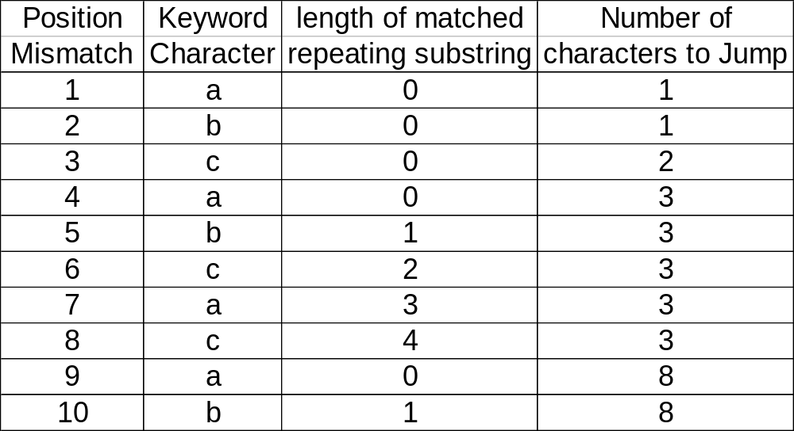
KMP Algorithm -- The Shift Table
Determine number of positions to shift when a mismatch is found.
COMP 336 Dik Lun LEE Department of Computer Science, HKUST, Slide <number>

Slide 25
KMP Algorithm -- The Performance
The shift table can be computed by processing the keyword in time O(m) where m is the length of the keyword.
  For each pattern character, need to compute the number of characters to skip when a mismatch is found.
The KMP algorithm takes O(m+n) time to solve the problem
The pointer in the text string is never decremented (compare this with the brute-force method)
COMP 336 Dik Lun LEE Department of Computer Science, HKUST, Slide <number>

Slide 26
Improvement on Basic KMP
BM benefits a lot from examining the mismatch text character, which is already fetched into main memory
Similar idea can be applied to the basic KMP method to further improve its speed (i.e., maximize the number of pattern shifts)
Basic KMP:
. . a b x y z . . .
a b a a b
a b a a b
shift[]: 1 1 2 2 3
a b a a b
Shifting 2 chars guarantees a mismatch
Recursively apply KMP on the mismatch x=a
Shift pattern by one more char
COMP 336 Dik Lun LEE Department of Computer Science, HKUST, Slide <number>

Slide 27
A Complete Example
.. x x x x x x ..
Basic KMP:
mismatch here
Improved KMP:
a b a a b
a b a a b
shift[]: 1 1 2 2 3
1 1 2 2 3
After 1 shift,a≠b, no change
a b a a b
1 1 3 2 4
a b a a b
After 2 shifts, a=a, shift[3]=++shift[1] ⇒ 3
a b a a b
After 2 shifts, a≠b, no change
After 3 shifts, b=b,
shift[5]=++shift[2] ⇒ =4
a b a a b
COMP 336 Dik Lun LEE Department of Computer Science, HKUST, Slide <number>

Slide 28
Example on Recursive Shifts
Increment to number of shifts should be recursively applied
a b a a b a a
Basic KMP:
1 1 2 2 3 3
Improved KMP:
After 3 shifts, a=a, “mismatch” at p[3] adds shift[3] to shift[6] => 5
After 5 shifts, a=a again, adds shift[1] to shift[6] => 6
The above example needs two iterations: shift[6] = shift[6] + shift[3] + shift[1]
What about shift[7]?
What if the pattern is ‘aaaaaaa’?
COMP 336 Dik Lun LEE Department of Computer Science, HKUST, Slide <number>

Slide 29
Pseudo Code
obtain basic KMP
m=pattern length (1..m)
for i=2 to m
do
offset = i – shift[i];
while ( pattern[ i ] == pattern[ offset ] )
new_shift[ i ] = shift[ i ] + shift[ offset ]
offset = i – shift[ i ]
done
COMP 336 Dik Lun LEE Department of Computer Science, HKUST, Slide <number>

Slide 30
Implementation (from shifts to array indexes)
p[j]: pattern array; s[i]: input text array
If p[j] ≠ s[i], then check shift[j]
  Shifting a pattern by m characters: j = 1, i++;
  Shifting a pattern by k < m characters: j = j - k; i unchanged
Next character pairs to be matched; j=j-k
k
A
1
j
pattern
A
x
text
y
1
i
COMP 336 Dik Lun LEE Department of Computer Science, HKUST, Slide <number>

Slide 31
Algorithm Choices: Heuristics
We presented a set of classic text search algorithms. There are a lot more in the literature.
If the length of the keyword is small (1-3 characters), use the brute force algorithm
If the alphabet size is large, the KMP algorithm is a good choice
As a short note about BM (Boyer and Moore) method:
  BM starts matching from the rightmost pattern character
  If a mismatch is found at the rightmost pattern character, shift can potentially be m characters if the mismatching text character does not appear in the first m-1 characters of the pattern
  Thus, BM is particularly good for long patterns
text: a b c d x f g h . . . .
pattern: a b c d e
a b c d e
COMP 336 Dik Lun LEE Department of Computer Science, HKUST, Slide <number>

Slide 32
Regular Expressions (RE) and Finite State Automata (FSA)
COMP 336 Dik Lun LEE Department of Computer Science, HKUST, Slide <number>

Slide 33
Regular Expressions (From Theorist Point of View)
A formal language for specifying strings
A simple string: abc
Alternation: a[x|y|z]bc => axbc, aybc, azbc
Zero or more repetitions: ab*c => ac, abc, abbc, abbbc, ….
Nesting of the above operations: a[x|y]*b => What does it match?
The above is the basic definition but different languages (Java, Perl, etc.) have different notations and richer functions (e.g., ab+c => abb*c)
COMP 336 Dik Lun LEE Department of Computer Science, HKUST, Slide <number>

Slide 34
Regular Expressions (In Programming Languages)
t.n =>: tan, Ten, tin, ton, t n, t#n, tpn, etc.
t[aeio]n => tan, Ten, tin, ton
t(a|e|i|o|oo)n => tan, Ten, tin, ton, toon
Quantifier | Number of Times
* | 0 or more times
+ | 1 or more times
? | 0 or 1 time
{n} | Exactly n number of times
{n,m} | n to m number of times
[0-9]{3}\-[0-9]{2}\-[0-9]{4}
[0-9]{3}\-?[0-9]{2}\-?[0-9]{4}
COMP 336 Dik Lun LEE Department of Computer Science, HKUST, Slide <number>

Slide 35
Regular Expressions (In Programming Languages)
[^x] => match any characters but x
[a-z] => any characters between a-z, inclusively
Character class | Equivalent to
\d | [0-9]
\D | [^0-9]
\w | [A-Z0-9]
\W | [^A-Z0-9]
\s | [\t\n\r\f]
\S | [^\t\n\r\f]
COMP 336 Dik Lun LEE Department of Computer Science, HKUST, Slide <number>

Slide 36
Finite State Automata (FSA)
a
abc
a
b
c
1
2
3
4
a
Transition Table
 | a | b | c | [^abc]
1 | 2 | 1 | 1 | 1
2 | 2 | 3 | 1 | 1
3 | 2 | 1 | 4 | 1
4 | 1 | 1 | 1 | 1
Note: All of the examples in these slides assume that matching stops after finding the first instance of the pattern, and all transitions from non-start states back to the start state are NOT shown
COMP 336 Dik Lun LEE Department of Computer Science, HKUST, Slide <number>

Slide 37
Finite State Automata (FSA)
a
ab+c
1
a
2
b
3
c
4
a
b
(ab)+c
Transition Table
 | a | b | c | [^abc]
1 | 2 | 1 | 1 | 1
2 | 2 | 3 | 1 | 1
3 | 4 | 1 | 4 | 1
4 | 1 | 3 | 1 | 1
5 | 1 | 1 | 1 | 1
4
b
a
1
a
2
b
3
c
5
a
a
1
a
2
b
3
c
4
⇐ Another design; check if they are the same
a
COMP 336 Dik Lun LEE Department of Computer Science, HKUST, Slide <number>

Slide 38
Finite State Automata (FSA)
ab[a-z]*c
a
b
c
1
2
3
4
a
¬c
a
ab*c
a
c
1
2
3
b
COMP 336 Dik Lun LEE Department of Computer Science, HKUST, Slide <number>

Slide 39
Finite State Automata (FSA)
abcabcacab
a
b
c
4
5
6
c
3
b
7
a
a
a
a
2
a
b
a
1
8
a
state 8
a
9
c
11
10
s: a b c a b c a b. . .
p: a b c a b c a c a b
a
b
COMP 336 Dik Lun LEE Department of Computer Science, HKUST, Slide <number>

Slide 40
Notes on the Demo Site
Online FSA demo (English version)
  http://www.let.rug.nl/~vannoord/fsademo/
Syntax is non-traditional:
  Concatenation: [a, b, c] matches “abc”
  Alternation: {a, b, c} matches “a”, “b” or “c”
  Repetition: {a, b, c}* matches strings of any length (including zero length) built on the alphabet: “a”, “b”, and “c”
Previous example: [{a, b, c}*, a, b, c, a, b, c, a, c, a, b, {a, b, c}*]
ab+c : [{a,b,c}*, a, b, {b}*, c, {a,b,c}*]
ab*c : [{a,b,c}*,a,{b}*,c,{a,b,c}*]
Note: The FSA shows all failure transitions; the previous slides do not for clarity reason
COMP 336 Dik Lun LEE Department of Computer Science, HKUST, Slide <number>

Slide 41
Finite State Automata (FSA)
Each text character is checked exactly once
  Slightly faster than KMP since in KMP each text character that causes a mismatch has to be matched against the shifted pattern again (why?)
Automatic compilation of regular expression into transition table
Compact representation of transition tables (minimize number of states)
COMP 336 Dik Lun LEE Department of Computer Science, HKUST, Slide <number>

Slide 42
UNIX grep Commands
fgrep
  matches fixed strings, implements KMP/BM type algorithm
grep
  matches limited regular expression
  . matches any character
  [a..c] matches a, b, or c
  … … refer to Unix man page
egrep
  matches full regular expression
  p+ one or more occurrences of p
  p? zero or 1 occurrences of p
  p | q p or q
  ( ) as in (p | q)+
COMP 336 Dik Lun LEE Department of Computer Science, HKUST, Slide <number>

Slide 43
Is Efficient Pattern Matching Needed/Not Needed?
Not needed:
  If text is stored on disk, full text scanning needs to read the file into main memory and then performs pattern matching: Disk reads dominate the cost
  Inverted file doesn't require pattern matching (of long strings)
Needed???
  Text may be cached in main memory (e.g., today’s news)
  Even if inverted file is used, you need pattern matching for:
    high-lighting matched parts
    if the inverted file doesn't contain word positions, need pattern matching to confirm occurrences of phrases
  Information push: lots of user profiles (patterns/keywords) to match a few new incoming files (e.g., emails)
COMP 336 Dik Lun LEE Department of Computer Science, HKUST, Slide <number>

